Slide 1
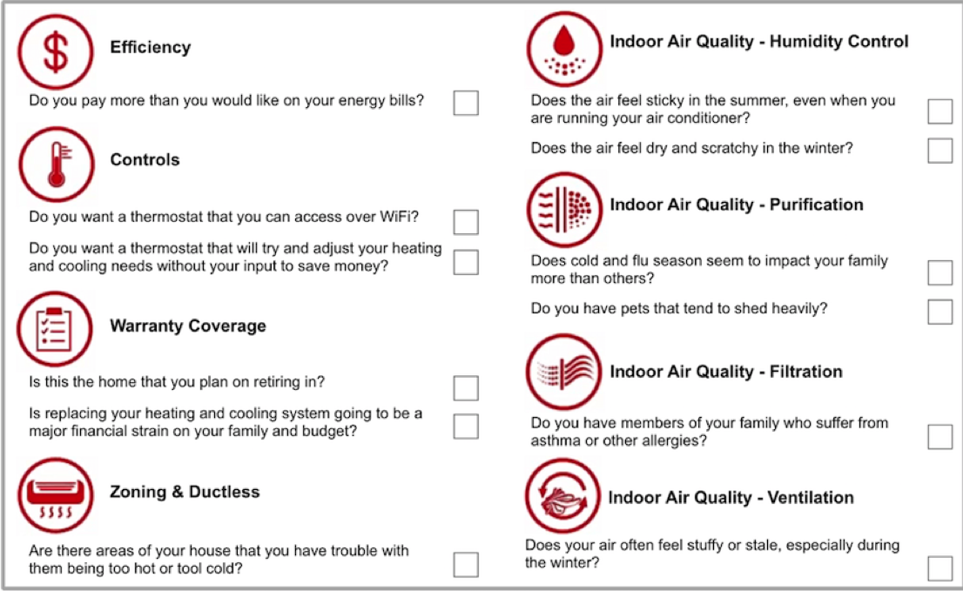

Slide 2
Three Things Make Up The Price
1. Capacity and Size of your new system.
(Comfort Health Safety)
2. Additional Work
(Health - Safety – Code )
3. Which System Features Make Sense?
(What problems do you want solved?)
We will review all system features until you are comfortable with the price.

Slide 3
Three Things Make Up The Price
1. Capacity and Size of your new system
(Comfort Health Safety)
2. Additional Work
(Health - Safety – Code )
3. Which System Features Make Sense?
(What problems do you want solved?)
We will review all system features until you are comfortable with the price.

Slide 4
Three Things Make Up The Price
1. Capacity and Size of your new system.
(Comfort Health Safety)
2. Additional Work
(Health - Safety – Code )
3. Which System Features Make Sense?
(What problems do you want solved?)
We will review all system features until you are comfortable with the price.

Slide 5
Three Things Make Up The Price
1. Capacity and Size of your new system.
(Comfort Health Safety)
2. Additional Work
(Health - Safety – Code )
3. Which System Features Make Sense?
(What problems do you want solved?)
We will review all system features until you are comfortable with the price.

Slide 6
Workforce Protocol
All Crew Members must have their
temperature tested twice per day.
No Crew Member will be permitted to
work with in any social work related
Environment with any fever – dry cough –
Cold or Flu symptom or Corona 19 symptoms
until such a time that a medical physician or
Certified Testing Station administers a test
for Covid 19 and verifies no infection.

Slide 7
Worksite Protocol
All Crew Members are required to:
Wear facemasks
Wear Gloves
Wear Shoe covers
Minimize all social interaction with customers
Isolate the work area from the living space
Sweep Clean and Disinfect the work area
at the end of every day
Disinfect hands with Sanitizer often
Take temperature before and after work

Slide 8
Worksite Protocol
Isolating working area from the living space:
Plastic wall covers will be used
(with painters Tape) to isolate living areas
Floor Saver Runners will be used
to protect the floor
Face Mask to be worn at all times
Shoe Covers to be worn at all times
Gloves to be worn at all times
Hand Sanitizer
No Smoking during working hours

Slide 9
Worksite Protocol
Post Installation Clean up and Sanitation:
All plastic wall covers and floor runners are to be extracted and placed in plastic trash bags – sanitized with disinfectant and sealed.
Work areas to be swept and disinfected
as necessary.

Slide 10
Work-Scope Protocol
File for the work permit
Schedule your city (County) inspection
Licensed – Bonded and Insured
Certified – Professional Installation crew
Remove and Recycle Old System
Dispose of all associated waste materials
Test and Balance your new system
24/7 Service
Abide by Company Core Values
Abide by Workforce and Worksite Protocol

Slide 11
Up flow Gas Furnace & A/C
Operation
c

Slide 12
Up flow Gas Furnace & A/C
Heating Operation
√
c

Slide 13
Up flow Gas Furnace & A/C
Cooling Operation
√
c

Slide 14
Up flow Gas Furnace & A/C
Operation
Questions?
√
c

Slide 15
Up flow Gas Furnace & A/C
Healthy Options
√
Filtration
Purification
Humidification
c

Slide 16
Up flow Gas Furnace & A/C
Healthy Options
√
Filtration
Purification
Humidification
c
Air Filters have a range of efficiency
From 2 (lowest efficiency) up to 16
(Highest efficient without a bypass).
2 ---- 8 ----16
Filter Efficiency

Slide 17
Up flow Gas Furnace & A/C
Healthy Options
√
Filtration
Purification
Humidification
c
The Human Body Filters the air
at an Efficiency Rating of 8.
2 ---- 8 ----16
Filter Efficiency

Slide 18
Up flow Gas Furnace & A/C
Healthy Options
√
Filtration
Purification
Humidification
c
A filter rated better than an 8 helps your body recover from airborne contaminants.
2 ---- 8 ----16
Filter Efficiency

Slide 19
Up flow Gas Furnace & A/C
Healthy Options
√
Filtration
Purification
Humidification
c
UV Air Purification
Disinfects the air and reduces the spread of Germs and Viruses

Slide 20
Up flow Gas Furnace & A/C
Healthy Options
√
Filtration
Purification
Humidification
c
UV Surface Purification
Kills Viruses and Micro Organisms
on your indoor coil minimizing the spread of Germs and Viruses.

Slide 21
Up flow Gas Furnace & A/C
Healthy Options
√
Filtration
Purification
Humidification
c
UV Technology has been proven highly effective in purifying dental and surgical equipment, drinking water, surgery rooms.

Slide 22
Up flow Gas Furnace & A/C
Healthy Options
√
Filtration
Purification
Humidification
c
UV Technology has been proven highly effective in purifying air in residential homes and businesses for over 15 years.

Slide 23
Up flow Gas Furnace & A/C
Healthy Options
√
Filtration
Purification
Humidification
c
Keeping the humidity above 35%
will keep your body hydrated which will:
Support a healthy Immune system
Reduce transferring cold and flu viruses
Keep your home more comfortable

Slide 24
Up flow Gas Furnace & A/C
Healthy Options
Questions?
√
c

Slide 25
Up flow Gas Furnace & A/C
System Features
√
100%
c
0%
Single Stage
Two Stage
Variable
Temperature & Humidity
Filtration & Purification
Noise & Efficiency

Slide 26
Up flow Gas Furnace & A/C
System Features:
√
Single Stage
Performs similar to Basic systems
c
100%
0%
Noise similar to existing
Slightly more efficient
Single Stage
Two Stage
Variable
100%
Temperature & Humidity
0%
Filtration & Purification
Noise & Efficiency

Slide 27
Up flow Gas Furnace & A/C
System Features
√
Single Stage
Performs similar to Basic system
c
New Warranties
More Efficient
Slightly quieter
Single Stage
Two Stage
Variable
100%
Temperature & Humidity
0%
Filtration & Purification
2-3 Degree
Temp Swing
1-2 Degree
Temp Swing
1 Degree
Temp Swing
Noise & Efficiency

Slide 28
Up flow Gas Furnace & A/C
System Feature:
√
Two Stage
Performs better than a Basic systems
c
100%
0%
Single Stage
Two Stage
Variable
100%
Temperature & Humidity
0%
Filtration & Purification
2-3 Degree
Temp Swing
1-2 Degree
Temp Swing
1 Degree
Temp Swing
Noise & Efficiency

Slide 29
Up flow Gas Furnace & A/C
System Features:
√
Two Stage
Performs better than a Basic systems
c
Better Humidity & Temperature Control
More Efficient & Better Warranties
Up To 30% Quieter
Single Stage
Two Stage
Variable
100%
Temperature & Humidity
0%
Filtration & Purification
2-3 Degree
Temp Swing
1-2 Degree
Temp Swing
1 Degree
Temp Swing
Noise & Efficiency

Slide 30
Up flow Gas Furnace & A/C
System Feature:
√
Variable Speed
Performs better than any other system
c
100%
0%
Single Stage
Two Stage
Variable
100%
Temperature & Humidity
0%
Filtration & Purification
2-3 Degree
Temp Swing
1-2 Degree
Temp Swing
1 Degree
Temp Swing
Noise & Efficiency

Slide 31
Up flow Gas Furnace & A/C
System Features:
√
Variable Speed
Performs better than any other system
c
Precise Temperature & Humidity Control
24/7 Filtration & Purification
Quietest & Most Efficient
Best Warranties
Single Stage
Two Stage
Variable
100%
Temperature & Humidity
0%
Filtration & Purification
2-3 Degree
Temp Swing
1-2 Degree
Temp Swing
1 Degree
Temp Swing
Noise & Efficiency

Slide 32
Up flow Gas Furnace & A/C
System Features
Questions?
√
c
Single Stage
Two Stage
Variable
100%
Temperature & Humidity
0%
Filtration & Purification
2-3 Degree
Temp Swing
1-2 Degree
Temp Swing
1 Degree
Temp Swing
Noise & Efficiency

Slide 33
Up flow Gas Furnace & A/C
System Features
Our Next Step is to determine
which system makes sense for you
√
c
Single Stage
Two Stage
Variable
100%
Temperature & Humidity
0%
Filtration & Purification
2-3 Degree
Temp Swing
1-2 Degree
Temp Swing
1 Degree
Temp Swing
Noise & Efficiency

Slide 34
Up flow Gas Furnace & A/C
System Features
Would anyone else interested
In the system design and the price
Be joining us?
√
c
Single Stage
Two Stage
Variable
100%
Temperature & Humidity
0%
Filtration & Purification
2-3 Degree
Temp Swing
1-2 Degree
Temp Swing
1 Degree
Temp Swing
Noise & Efficiency

Slide 35
Three Things Make Up The Price
1. Capacity and Size of your new system.
(Comfort Health Safety)
2. Additional Work
(Health - Safety – Code )
3. Which System Features Make Sense?
(What problems do you want solved?)
We will review all system features until you are comfortable with the price.

